Slide 1



Department of Computer Engineering
Academic Year 2024-25
Case Study: Environmental Domain
Problem : Multiple linear regression comment on Correlation with proper example
Group Members:
Pratul Jagtap – TY-A-46
Pranav Lohar – TY-A-53
Raj More – TY-A-61
Guide:
Dr. Jyoti Wadmare

Slide 2
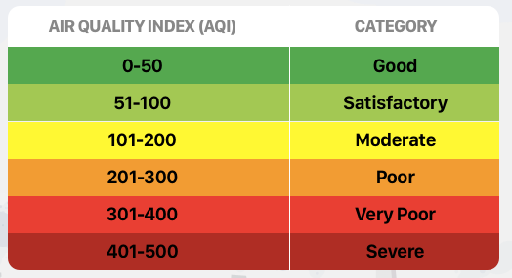
Introduction
The Air Quality Index (AQI) is a standardized system used to measure and report the quality of the air in a specific area.
It converts complex air pollution data into a simple, understandable number and color code that tells you how polluted the air currently is or how polluted it is forecast to become.
Air quality levels are grouped into different categories based on how much of certain pollutants are present in the air and how they can affect people's health.

Slide 3

Introduction
Importance of Monitoring AQI:
Health Monitoring: AQI provides a measure of how safe the air is to breathe. High levels of pollutants can lead to respiratory issues, cardiovascular problems, and other health complications.
Environmental Policy Making: AQI data helps policymakers enforce regulations, design pollution control strategies, and evaluate the impact of interventions.
Urban Planning: Helps in identifying pollution hotspots, guiding city development and traffic planning to reduce emissions.

Slide 4

Problem Statement
Objectives:
Variables such as distance from industrial areas, population density, green cover, pollutants distribution are expected to influence AQI levels.
Some predictors may have a greater impact on AQI than others. The study aims to quantify the influence of each variable to determine which factors contribute most to air pollution levels.
Objectives

Slide 5

Proposed Methodology
Methodology:
We apply Multiple Linear Regression (MLR) to study how environmental and socio-economic factors influence AQI. The process involves collecting data on pollutants, population density, industrial proximity, and green cover.
Model performance is evaluated using R² and Correlation Coefficient to determine the strength and significance of each predictor.

Slide 6

Data Processing
Data Collection:
The dataset contains environmental and socio-economic variables collected to analyze their impact on Air Quality Index (AQI). It includes multiple parameters that may or may not influence air pollution levels.
It includes a total of 500 locations, with various parameters like temperature, humidity and pollutant concentration, etc.

Slide 7
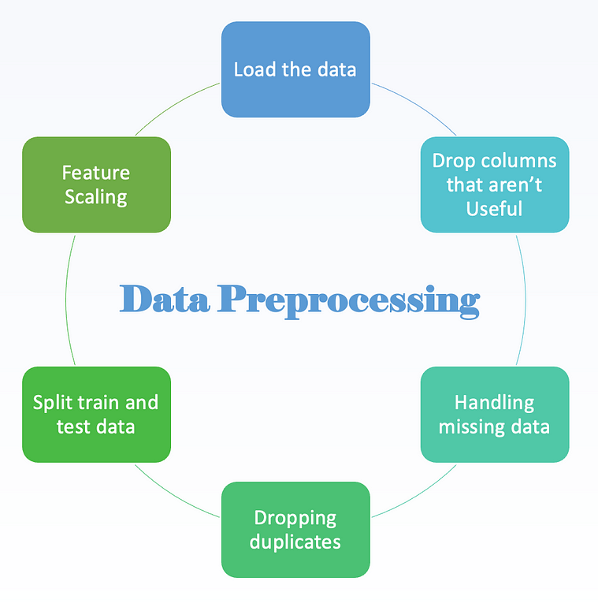
Data Processing
Data Preprocessing:
Due to the large amount of data present, it is important to preprocess the dataset to ensure that outlier/incorrect data do not influence the decision-making capability of the model.
Clean the dataset by eliminating null values, normalizing or replacing outlier data and removing of parameters like latitude and longitude of locations and other features that don’t influence the target variable

Slide 8

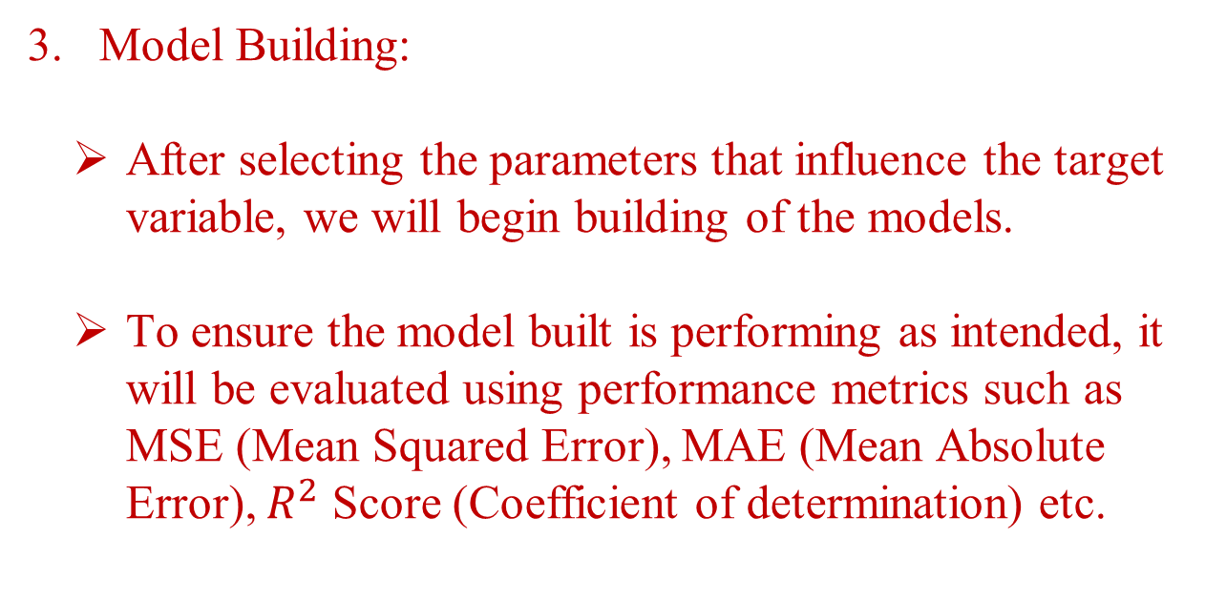
Data Processing
Model Building:
After selecting the parameters that influence the target variable, we will begin building of the models.
To ensure the model built is performing as intended, it will be evaluated using performance metrics such as MSE (Mean Squared Error), MAE (Mean Absolute Error), $R^{2}$ Score (Coefficient of determination) etc.

Slide 9
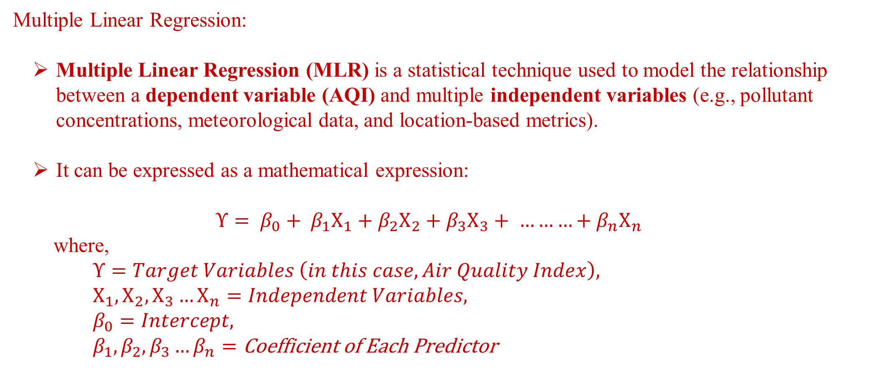
Methodology
Multiple Linear Regression:
Multiple Linear Regression (MLR) is a statistical technique used to model the relationship between a dependent variable (AQI) and multiple independent variables (e.g., pollutant concentrations, meteorological data, and location-based metrics).
It can be expressed as a mathematical expression:
$$Υ= β_{0}+ β_{1}Χ_{1}+β_{2}Χ_{2}+β_{3}Χ_{3}+ ………+β_{n}Χ_{n}$$
where,
$$Υ=Target Variables \left(in this case, Air Quality Index\right),$$
$$Χ_{1}, Χ_{2},Χ_{3}…Χ_{n}=Independent Variables,$$
$$β_{0}=Intercept,$$
$$β_{1},β_{2},β_{3}…β_{n}=\text{Coefficient} \text{of} \text{Each} \text{Predictor}$$

Slide 10
Methodology
Correlation:
Correlation measures the strength and direction of a linear relationship between two variables. It helps determine which features are strongly related (positive or negative) to the target variable and which are unrelated to the same.
The Coefficient of Correlation’s value ranges between -1 and 1, where:
+1 | → | Positive Correlation (Target Variable ↑ , Independent Variable ↑)
0 | → | No correlation
-1 | → | Negative Correlation (Target Variable ↑ , Independent Variable ↓)

Slide 11
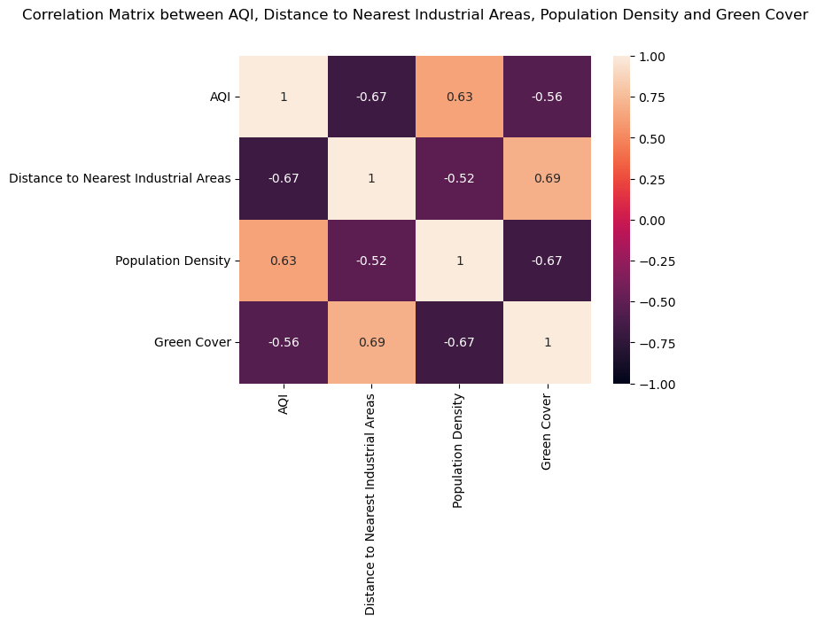
Result

Slide 12
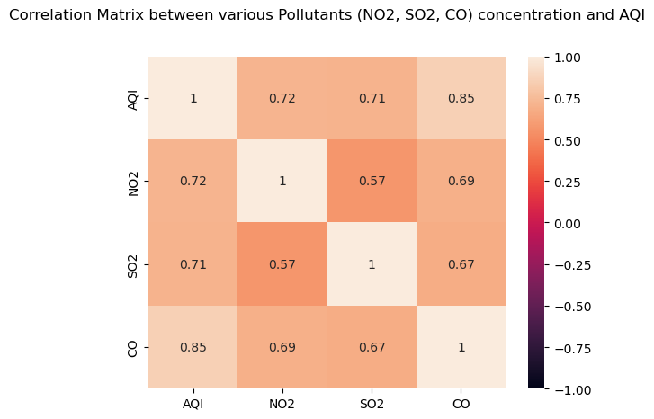
Result

Slide 13
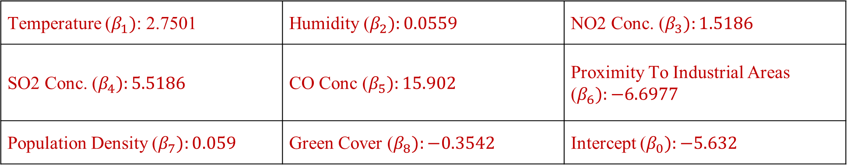
Result
Performance Metrics:
Mean Absolute Error (MAE): 55.4753
Mean Squared Error (MSE): 6032.3804
R2 Score: 0.6762
Feature Coefficients:
Temperature ($β_{1})$: 2.7501 | Humidity ($β_{2}):0.0559$ | NO2 Conc. ($β_{3}):1.5186$
SO2 Conc. ($β_{4}):5.5186$ | CO Conc ($β_{5}):15.902$ | Proximity To Industrial Areas ($β_{6}):−6.6977$
Population Density ($β_{7}):0.059$ | Green Cover ($β_{8}):−0.3542$ | Intercept ($β_{0}):−5.632$

Slide 14

Conclusion
The analysis of the AQI dataset using Multiple Linear Regression (MLR) emphasizes the influence of various environmental and demographic predictors on air quality.
Pollutants like NO₂, SO₂, and CO show a strong positive influence on AQI, indicating their direct role in deteriorating air quality. In contrast, features like Green Cover are negatively correlated, demonstrating a protective impact.
The MLR model captures the linear relationships among predictors and AQI, providing a clear interpretation of how each factor affects air quality.

